Slide 1
Huffman Coding

Slide 2
Huffman Coding-
Huffman Coding is a famous Greedy Algorithm.
It is used for the lossless compression of data.
It uses variable length encoding.
It assigns variable length code to all the characters.
The code length of a character depends on how frequently it occurs in the given text.
The character which occurs most frequently gets the smallest code.
The character which occurs least frequently gets the largest code.
It is also known as Huffman Encoding.

Slide 3
Prefix Rule-
Huffman Coding implements a rule known as a prefix rule.
This is to prevent the ambiguities while decoding.
It ensures that the code assigned to any character is not a prefix of the code assigned to any other character.
Major Steps in Huffman Coding-
There are two major steps in Huffman Coding-
Building a Huffman Tree from the input characters.
Assigning code to the characters by traversing the Huffman Tree.

Slide 4
Huffman Tree-
The steps involved in the construction of Huffman Tree are as follows-
Step-01:
Create a leaf node for each character of the text.
Leaf node of a character contains the occurring frequency of that character.
Step-02:
Arrange all the nodes in increasing order of their frequency value.
Step-03:
Considering the first two nodes having minimum frequency,
Create a new internal node.
The frequency of this new node is the sum of frequency of those two nodes.
Make the first node as a left child and the other node as a right child of the newly created node.

Slide 5
Step-04:
Keep repeating Step-02 and Step-03 until all the nodes form a single tree.
The tree finally obtained is the desired Huffman Tree.
Time Complexity-
The time complexity analysis of Huffman Coding is as follows-
extractMin( ) is called 2 x (n-1) times if there are n nodes.
As extractMin( ) calls minHeapify( ), it takes O(logn) time.
Thus, Overall time complexity of Huffman Coding becomes O(nlogn).
Here, n is the number of unique characters in the given text.

Slide 6
PRACTICE PROBLEM BASED ON HUFFMAN CODING-
Problem-
A file contains the following characters with the frequencies as shown in next slide. If Huffman Coding is used for data compression, determine-
1. Huffman Code for each character
2. Average code length
3. Length of Huffman encoded message (in bits)

Slide 7
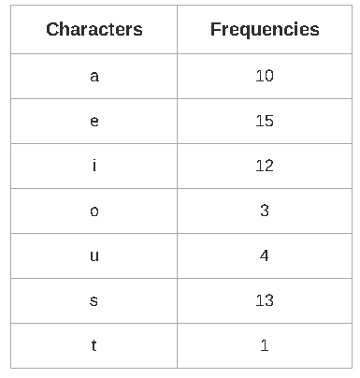

Slide 8
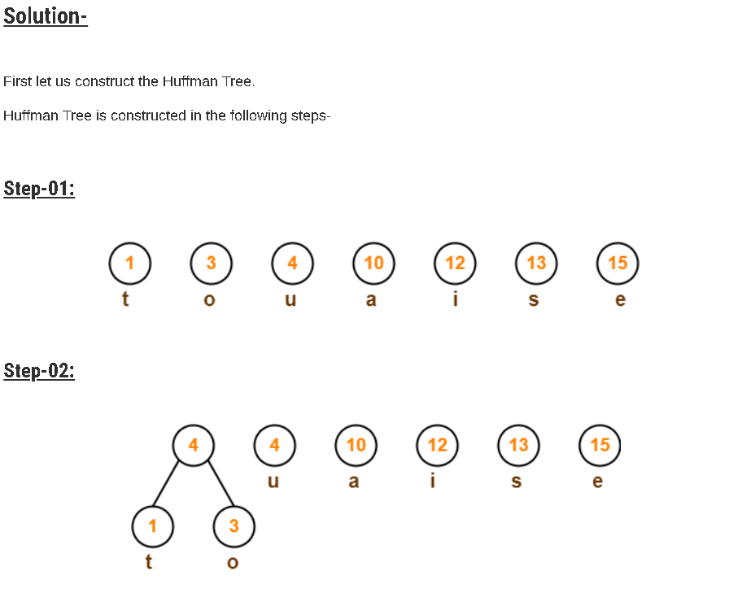

Slide 9
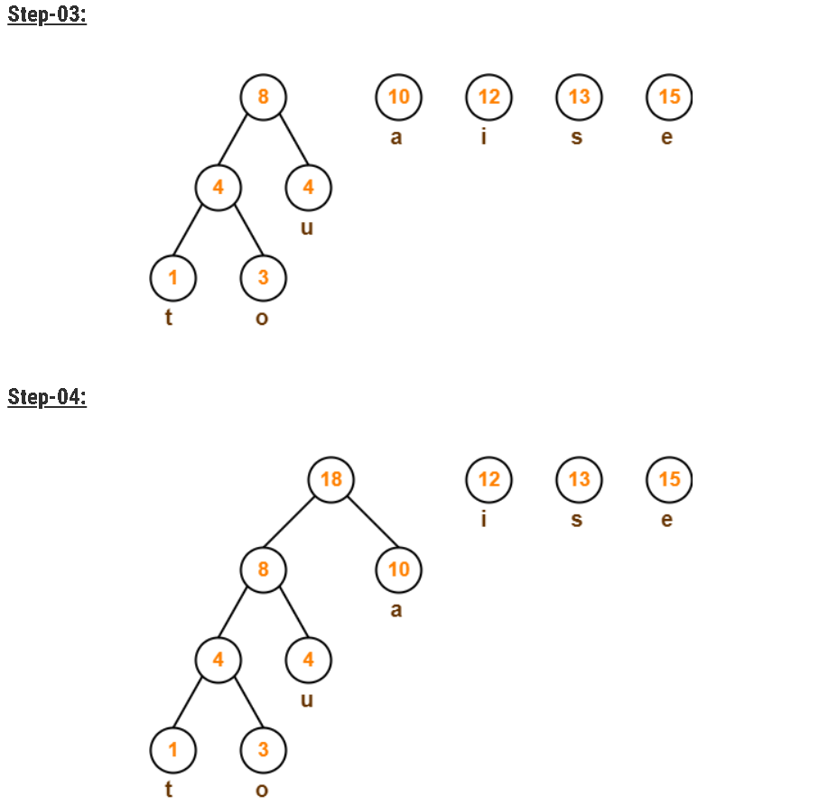

Slide 10
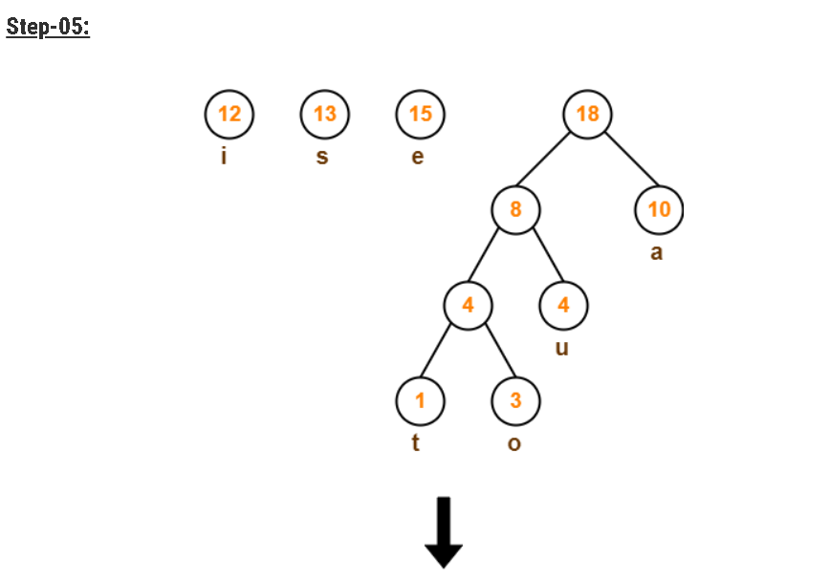

Slide 11
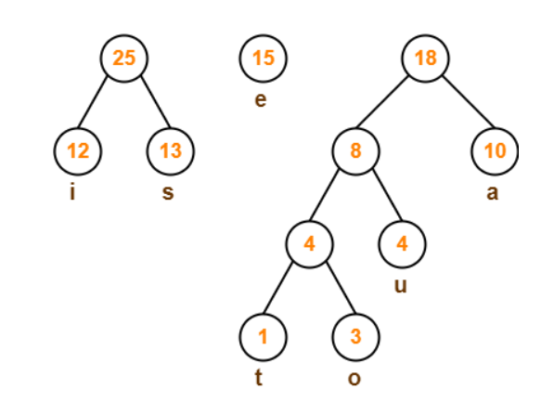

Slide 12
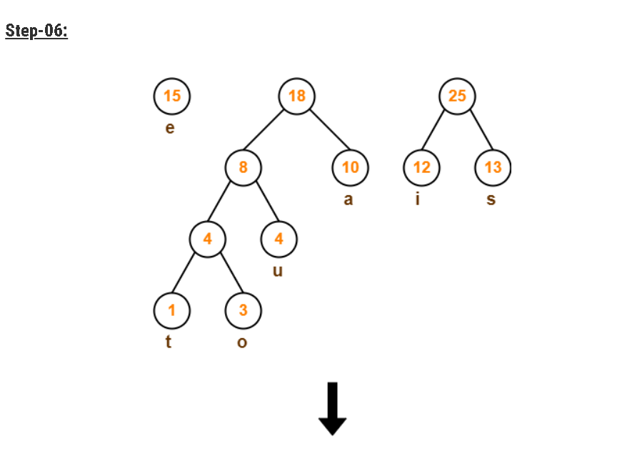

Slide 13
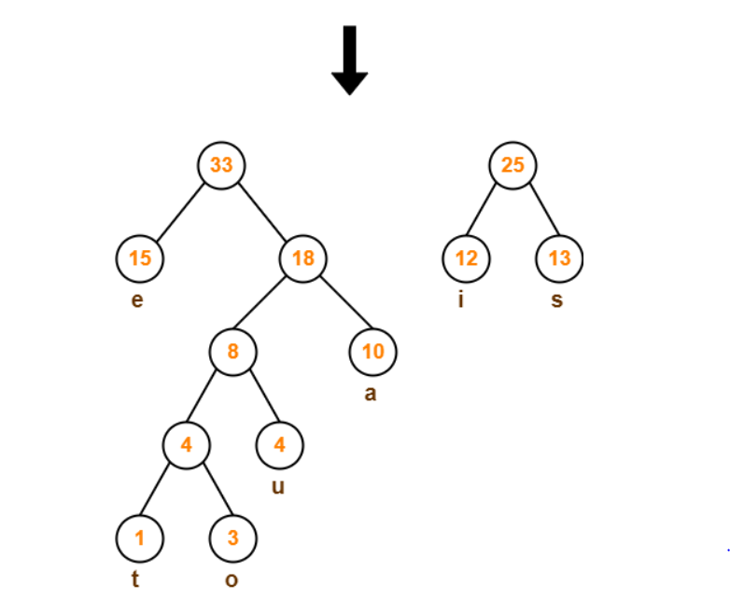

Slide 14
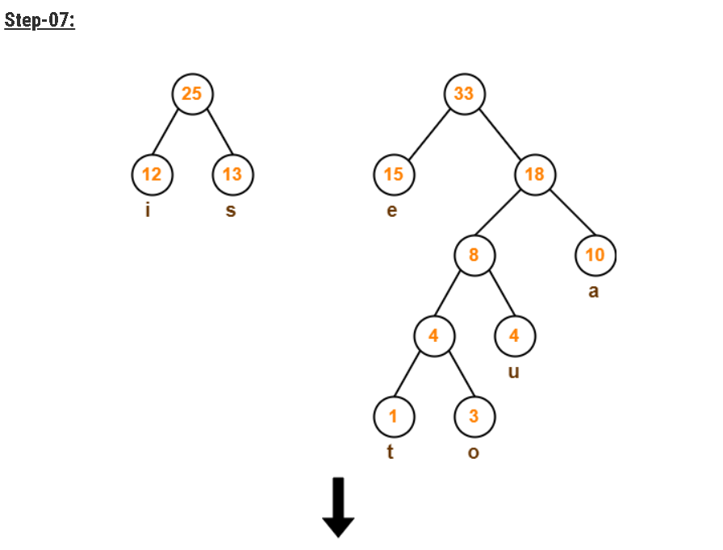

Slide 15
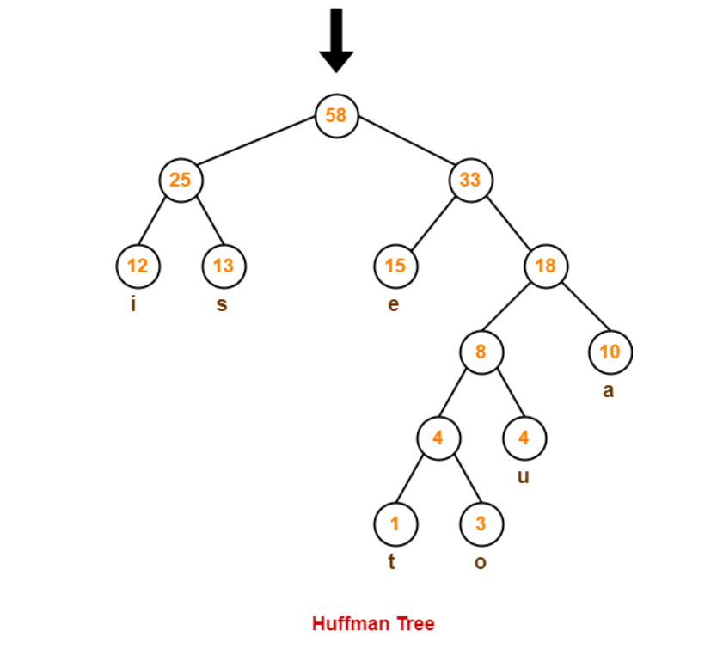

Slide 16
Now,
We assign weight to all the edges of the constructed Huffman Tree.
Let us assign weight ‘0’ to the left edges and weight ‘1’ to the right edges.
Rule
If we assign weight ‘0’ to the left edges, then assign weight ‘1’ to the right edges.
If we assign weight ‘1’ to the left edges, then assign weight ‘0’ to the right edges.
Any of the above two conventions may be followed.
But follow the same convention at the time of decoding that is adopted at the time of encoding.

Slide 17
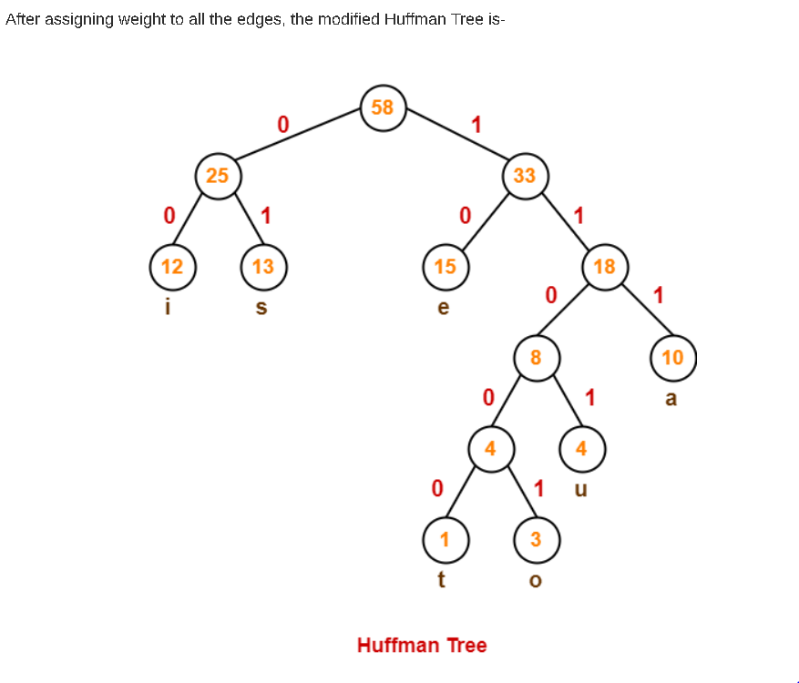

Slide 18
Now, let us answer each part of the given problem one by one-
1. Huffman Code For Characters-
To write Huffman Code for any character, traverse the Huffman Tree from root node to the leaf node of that character.
Following this rule, the Huffman Code for each character is-
a = 111
e = 10
i = 00
o = 11001
u = 1101
s = 01
t = 11000
From here, we can observe-
Characters occurring less frequently in the text are assigned the larger code.
Characters occurring more frequently in the text are assigned the smaller code.

Slide 19
2. Average Code Length-
Average code length = ∑ ( frequency_{i} x code length_{i} ) / ∑ ( frequency_{i} )
= { (10 x 3) + (15 x 2) + (12 x 2) + (3 x 5) + (4 x 4) + (13 x 2) + (1 x 5) } / (10 + 15 + 12 + 3 + 4 + 13 + 1)
= 2.52
3. Length of Huffman Encoded Message-
Total number of bits in Huffman encoded message
= Total number of characters in the message x Average code length per character
= 58 x 2.52
= 146.16
≅ 147 bits

